Slide 1


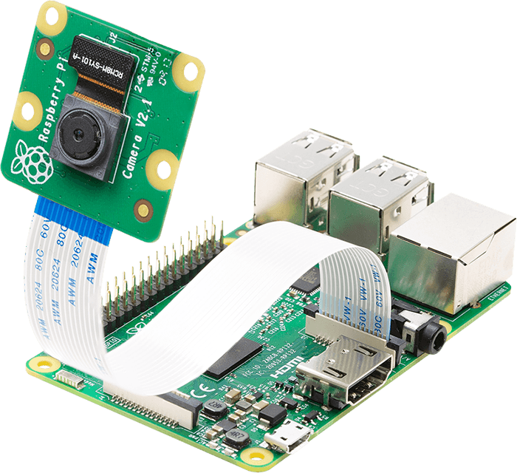
Development of iot-based solution for checking student attendance
Student 1: Nguyen Truong Thanh (1652557)
Student 2: Nguyen Anh Quan (1552310)
Supervise: PhD. Pham Hoang Anh
January 25th, 2021

Slide 2
Contents
Introduction
Literature Review
Theoretical Basis
Methodology
Evaluation and Testing
Conclusion

Slide 3
Introduction
Attendance marking
Traditionally marking
Fingerprint
RFID Card
Face Recognition

Slide 4
Literature review
Existing Literature | Limitations | Solution
Fingerprint | Employees have to wait on queues | Marking attendance automatically and quickly without waiting in long queues
Facial Recognition | Faces will change over time and it is difficult to recognize faces if the face is too far from the camera | Load student photos with relevant ID numbers on RFID tags and update student face on the database every 2 weeks
RFID Technology | Can make fake attendance | Verify faces by checking faces with facial recognition after being identified by RFID
The student will hear beep sound after recognition | Students do not receive any notices after marking attendance | Send email notifications to students after marking his/her attendance

Slide 5
Research objectives
Identify students using RFID
Identify students using face recognition
Register courses and subject on the system
Mark attendance on the database
Check whether the student attended to correct session
Send notification emails to students
Generate attendance reports

Slide 6
Theoretical basis
Radio Frequency Identification
Face Recognition
Facial Lankmark

Slide 7
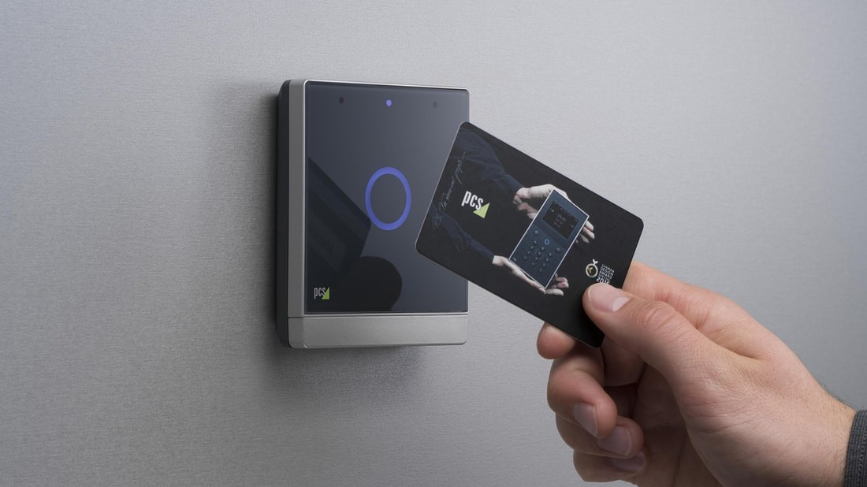
Radio frequency identification

Slide 8
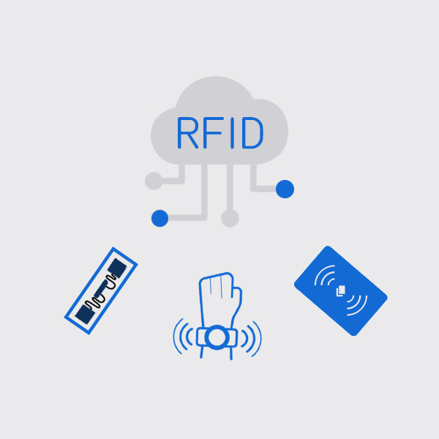
Introduction
Has a long history and is a part of both present andpast technological development.
Application:
– Inventory management – Asset tracking – Personnel tracking – Controlling access to restricted areas – ID Badging – Supply chain management

Slide 9
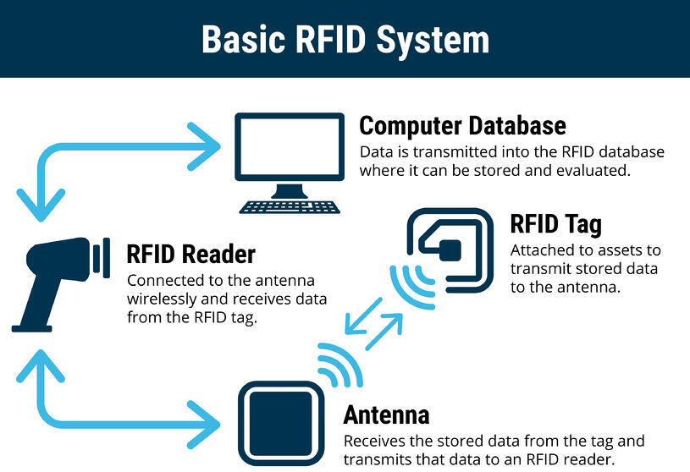
RFID system components

Slide 10
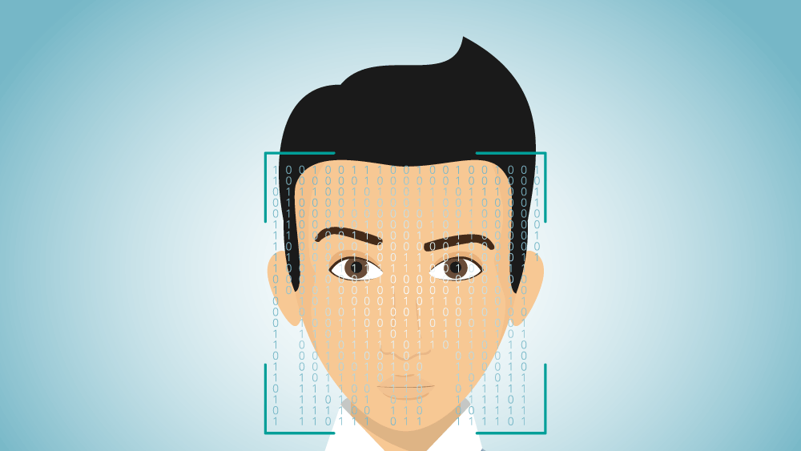
Face Recognition

Slide 11

Face detection
A computer technology being used in a variety of applications that identifies human faces in digital images.
Face detection can be regarded as a specific case of object-class detection.
Face-detection algorithms focus on the detection of frontal human faces.

Slide 12
Face recognition
Face recognition systems can be used to identify people in photos, video, or in real-time.
The face detection process is an essential step as it detects and locates human faces in images and videos.
The face capture process transforms analog information (a face) into a set of digital information (data) based on the person's facial features.
The face match process verifies if two faces belong to the same person.

Slide 13
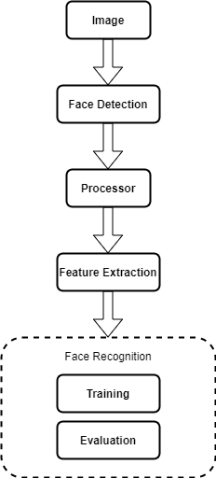
Face Recognition

Slide 14
Haar cascade classifier
A machine learning based approach where a cascade function is trained from a lot of positive and negative images.
The algorithm needs a lot of positive images (images of faces) and negative images (images without faces) to train the classifier.

Slide 15
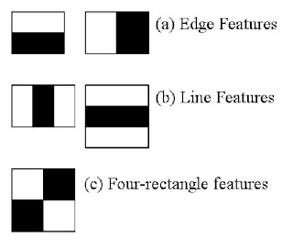
Haar cascade classifier
Each feature is a single value obtained by subtracting sum of pixels under the white rectangle from sum of pixels under the black rectangle.

Slide 16
Lbp (Local binary patterns) cascade classifier
To convert the image to grayscale.
For each pixel in the grayscale image, we select a neighborhood of size r surrounding the center pixel.
A LBP value is then calculated for this center pixel and stored in the output 2D array with the same width and height as the input image.

Slide 17
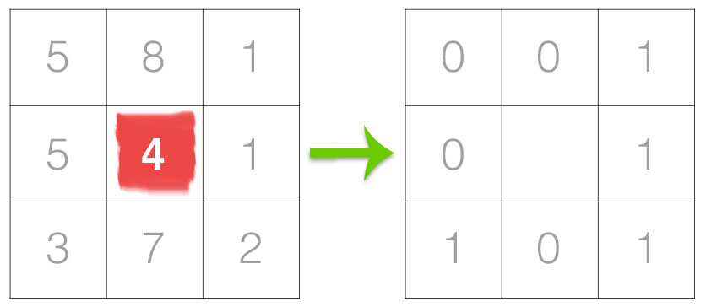
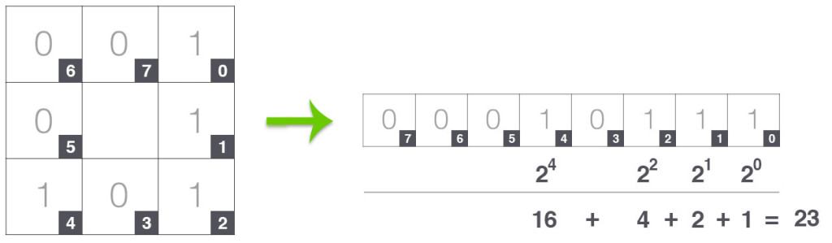
Lbp (Local binary patterns) cascade classifier

Slide 18
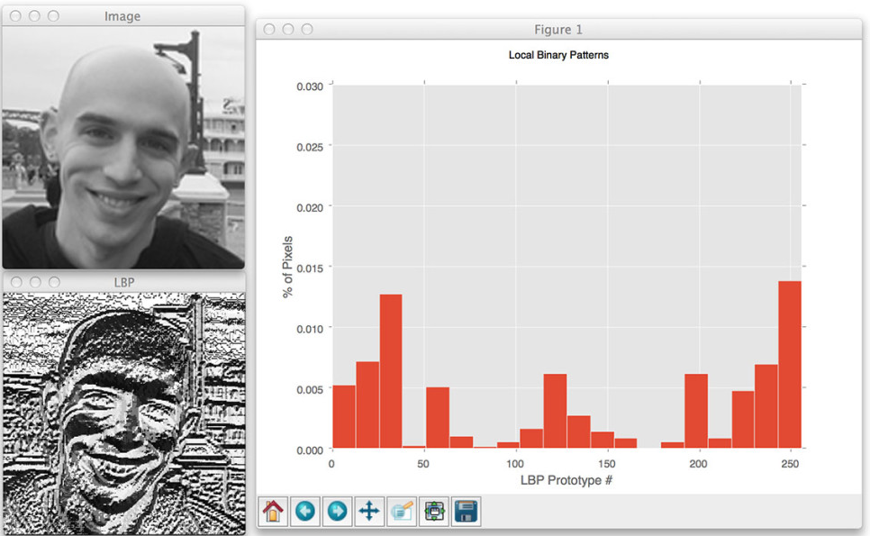

Slide 19

Opencv
OpenCV (Open Source Computer Vision Library) is an open source computer vision and machine learning software library.
Detect and recognize faces, identify objects, classify human actions in videos, track camera movements, track moving objects, etc.
Supports Windows, Linux, Android and Mac OS.

Slide 20
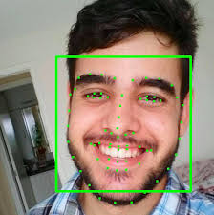
Facial landmarks

Slide 21
Facial landmarks
Facial landmarks are used to localize and represent salient regions of the face, such as: (eyes, eyebrows, nose, mouth, jawline)
Face alignment, head pose estimation, face swapping, blinl detection, etc.

Slide 22
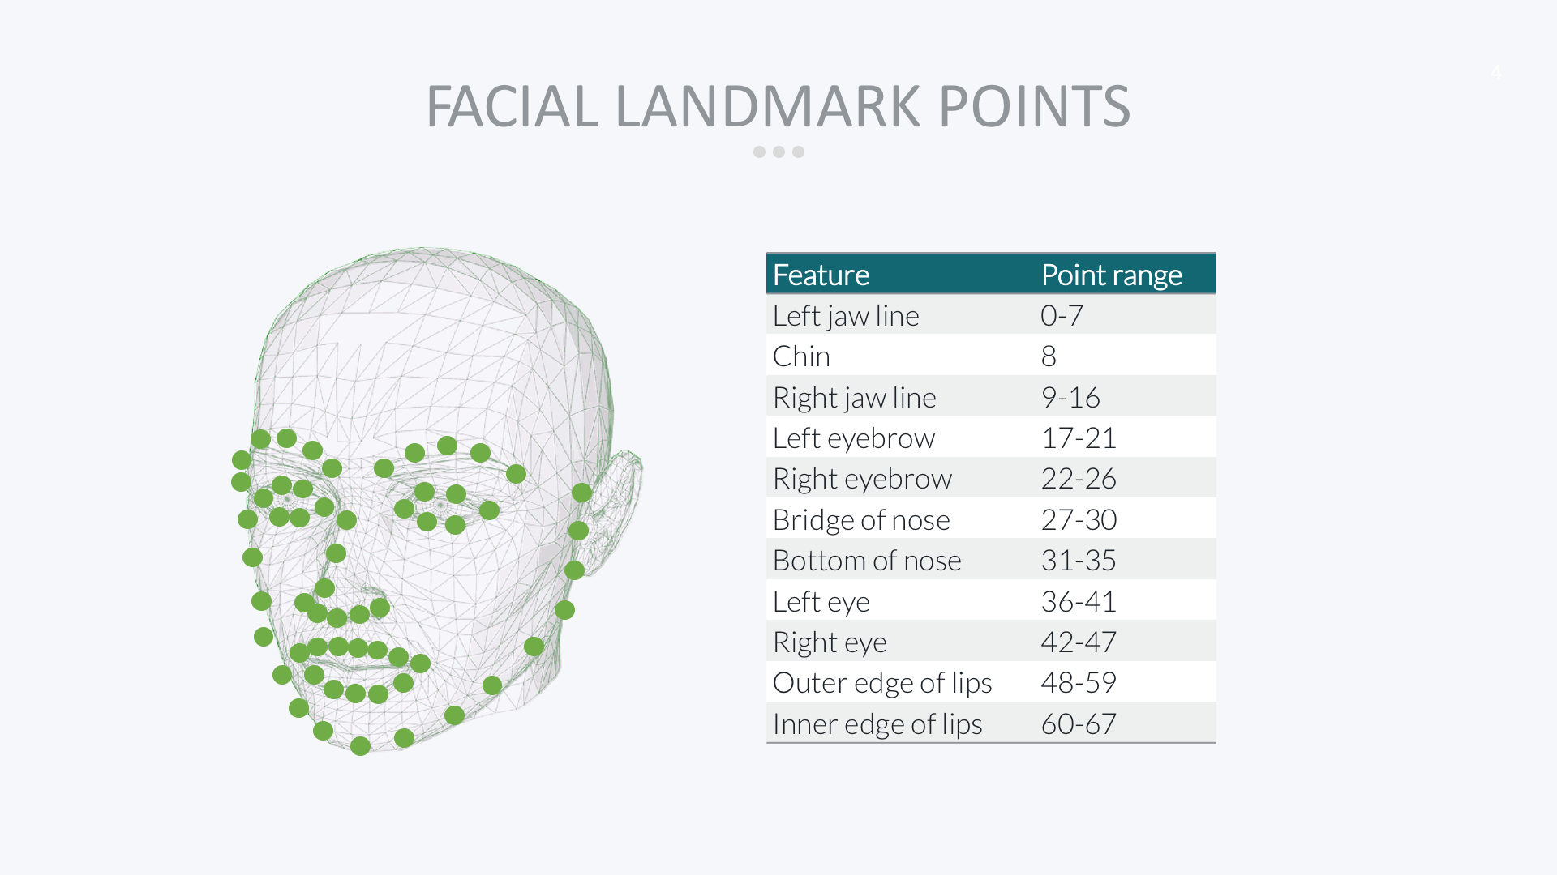

Slide 23
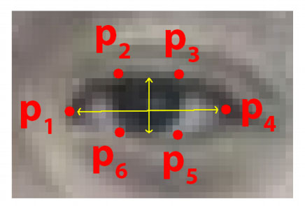
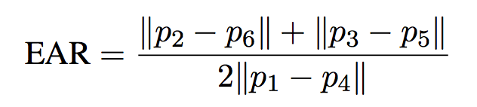
Eye aspect ratio (Ear)
Each eye is represented by 6 (x, y)-coordinates
There is a relation between the width and the height of these coordinates

Slide 24
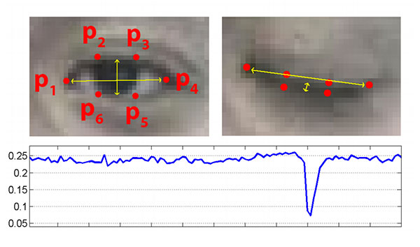

Slide 25
Methodology
Planning
Analysis
Design
Implementation

Slide 26

Planning
Problems
Traditional
RFID
Face Recognition
Fingerprint
Number of students

Slide 27

Analysis
RFID + Facial Recognition

Slide 28
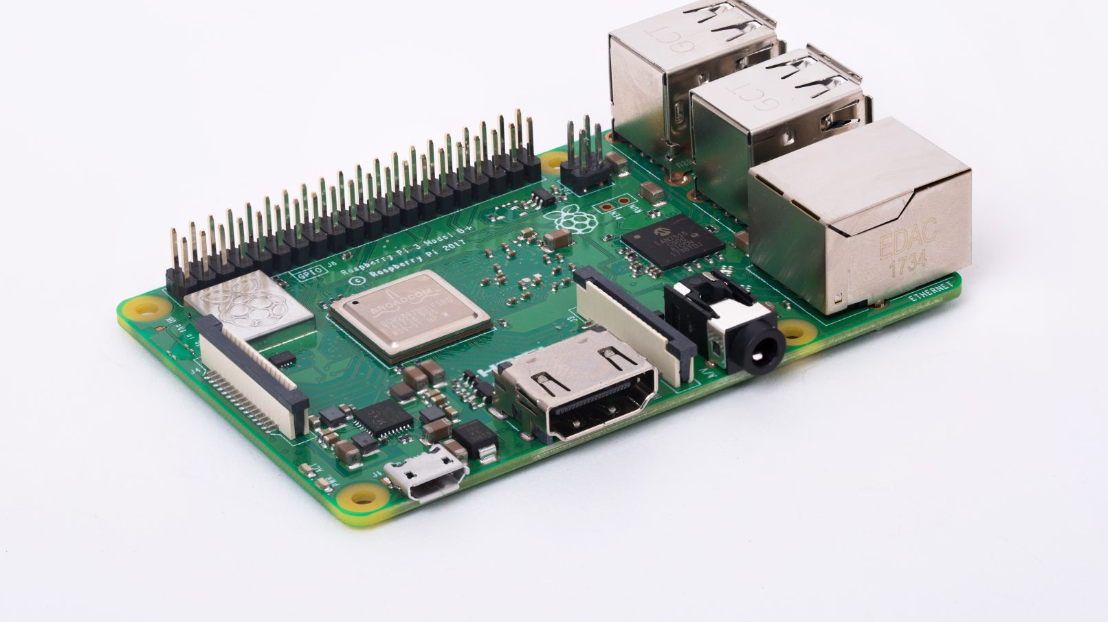
Design

Slide 29
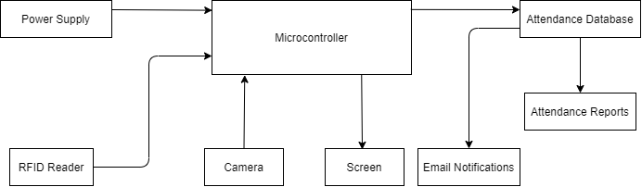
System Overview

Slide 30
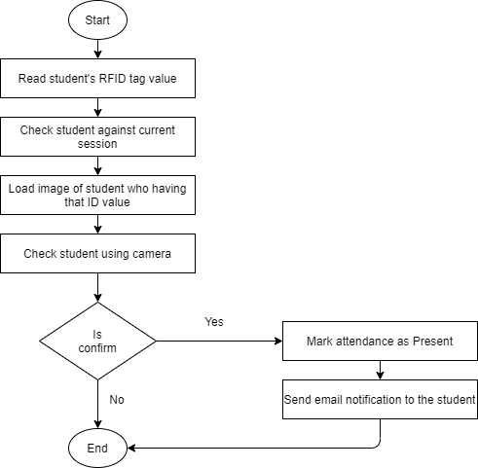
Flowchart

Slide 31
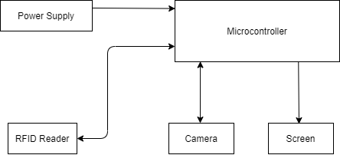
SYSTEM DESIGN

Slide 32


Slide 33
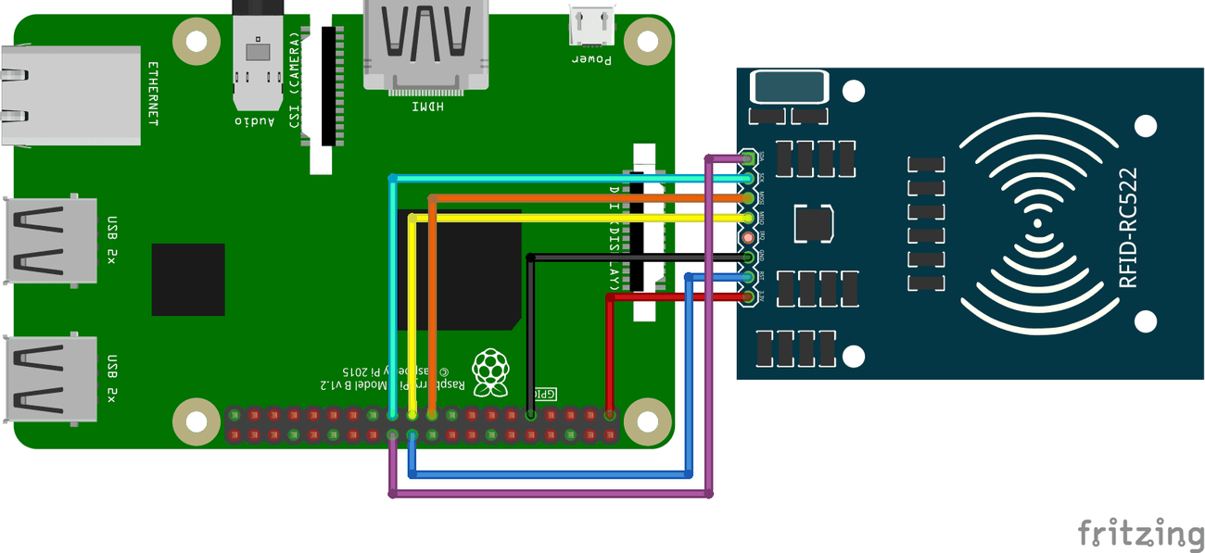

Slide 34
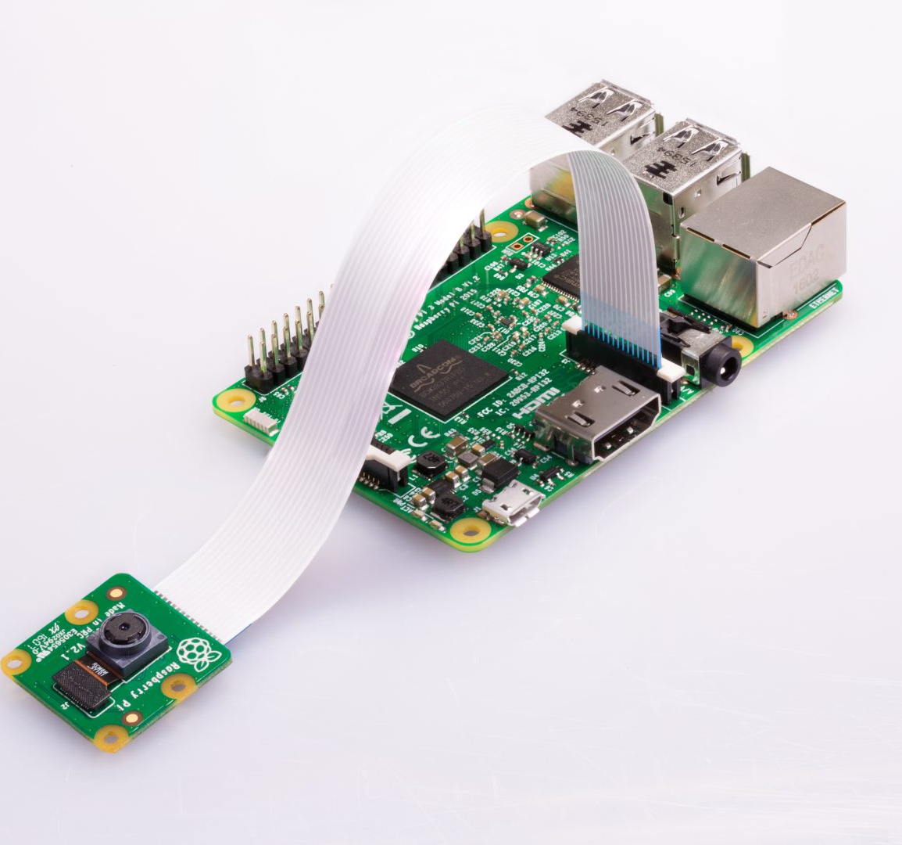
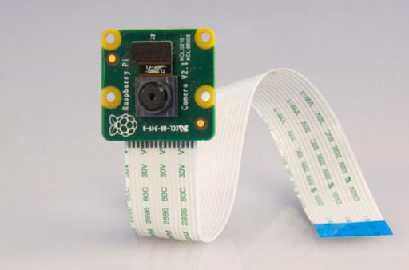

Slide 35
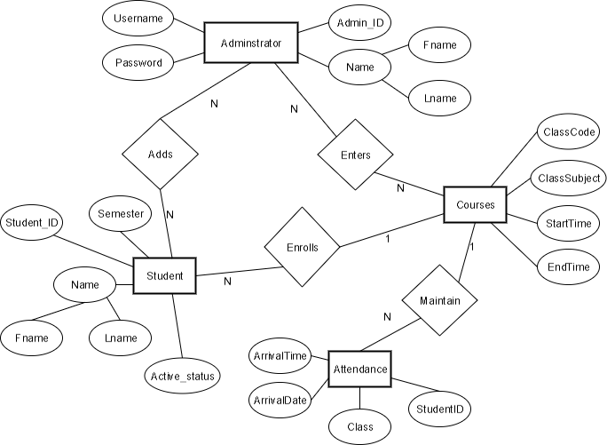
Er DIAGRAM OF DATABASE

Slide 36
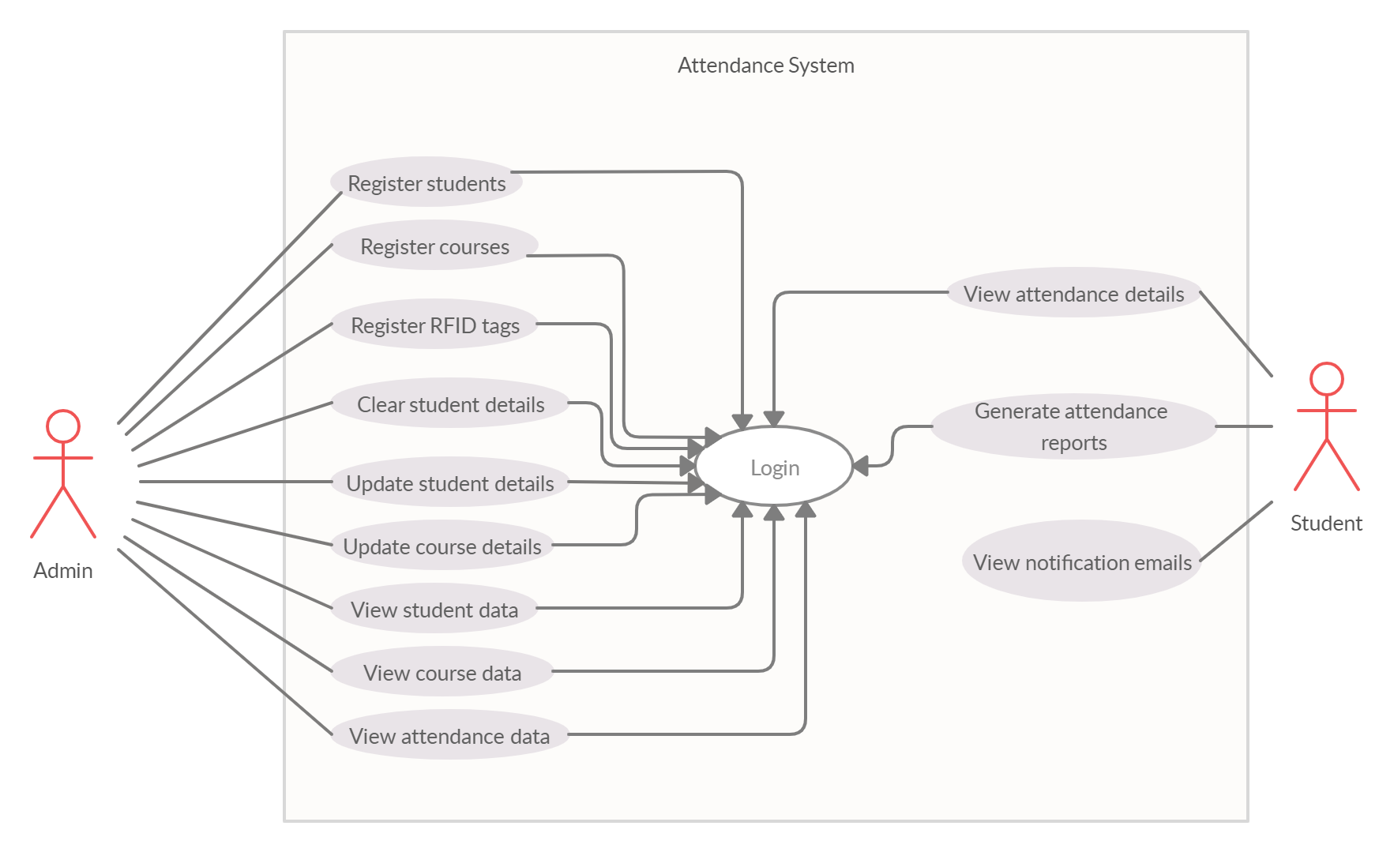
Usecase diagram

Slide 37

implementation

Slide 38
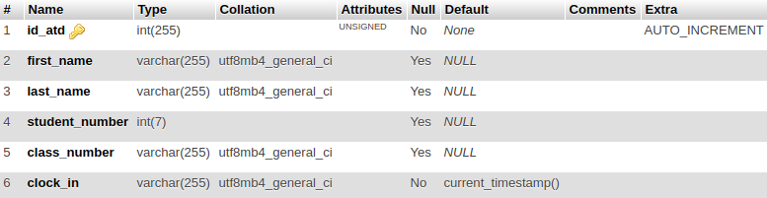
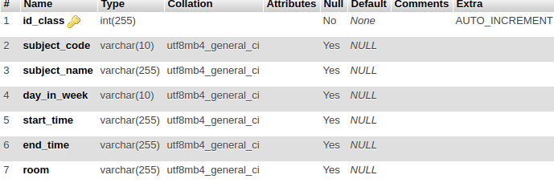
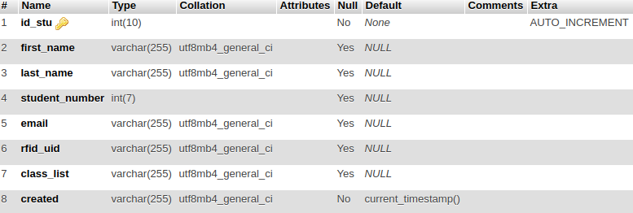
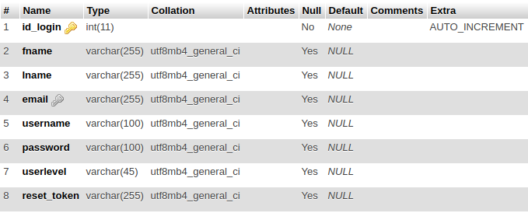
Database

Slide 39

python app

Slide 40
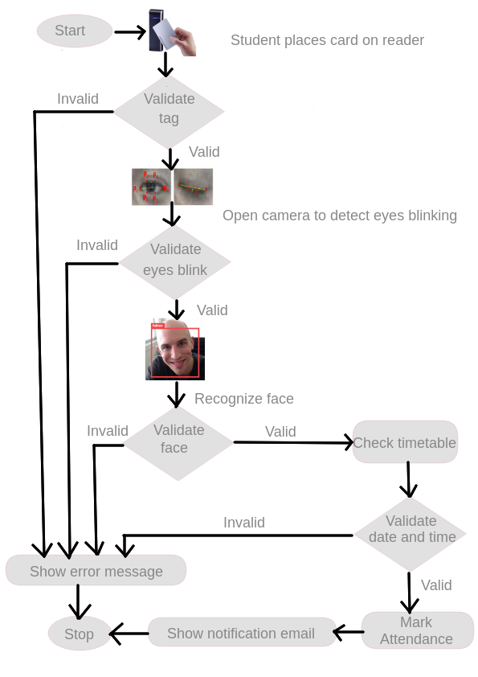
Marking attendance

Slide 41
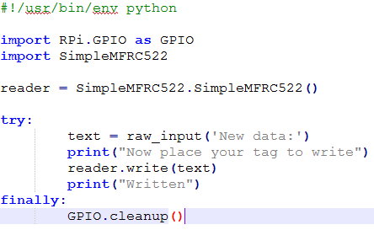
RFID

Slide 42
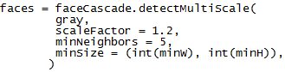
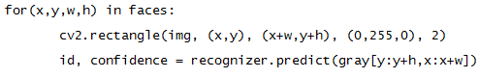
Face detection

Slide 43
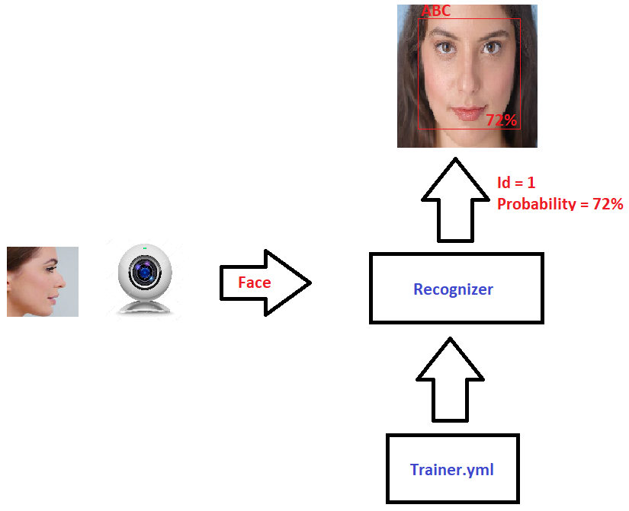
face recognition

Slide 44
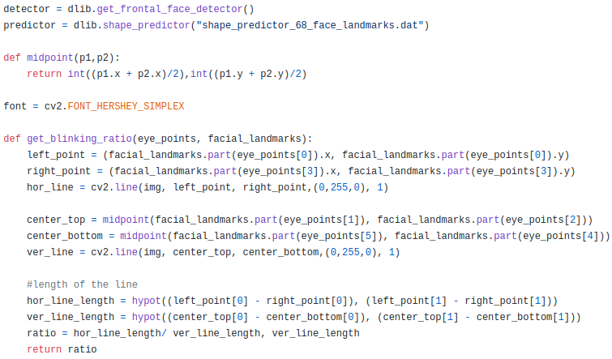
Eye blink detection

Slide 45
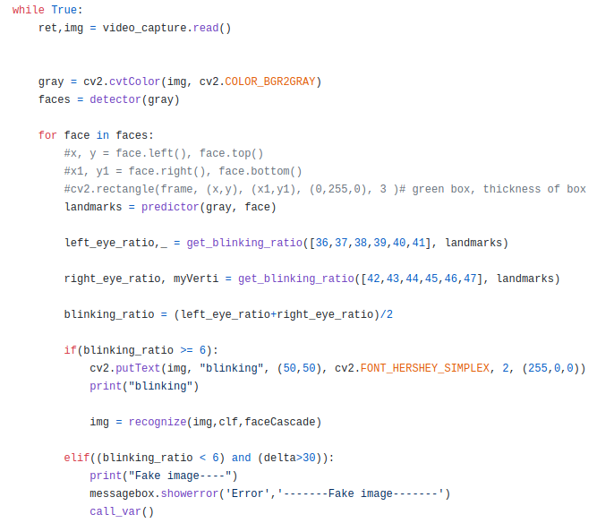
Eye blink detection

Slide 46
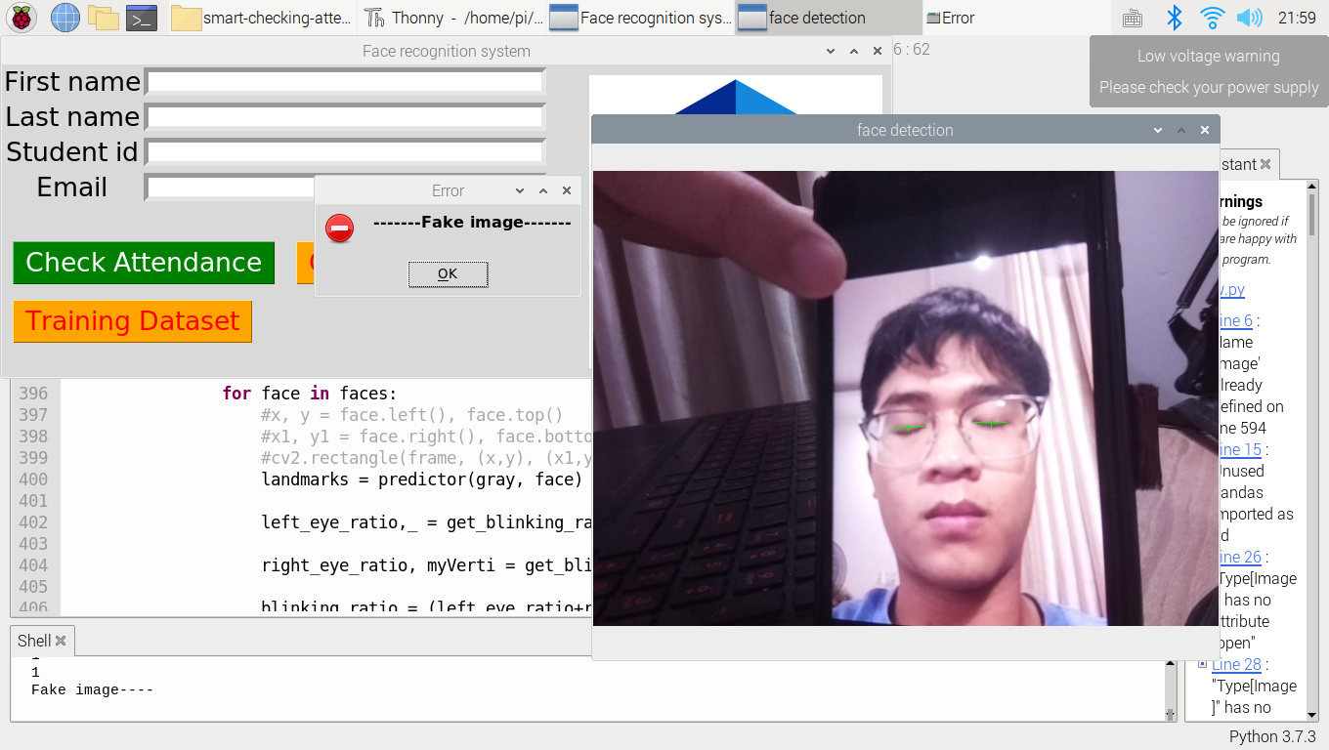

Slide 47
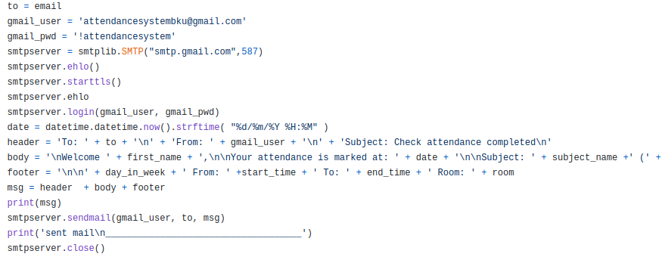
Send mail

Slide 48
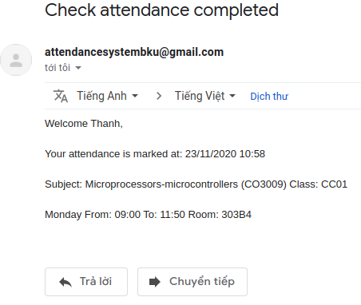
Send mail

Slide 49
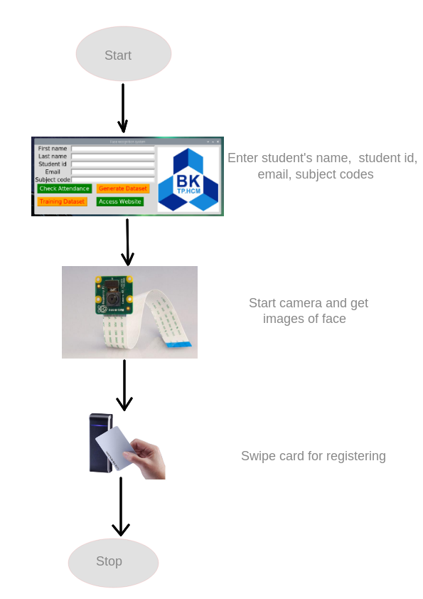
Register

Slide 50

Web app

Slide 51
Web app
Html, CSS, JavaScript, Ajax, Bootstrap, etc.
3 roles: admin, teacher, student
Data charts, search bar
Login, logout with session
Registration
Forgot password, confirm via email token

Slide 52
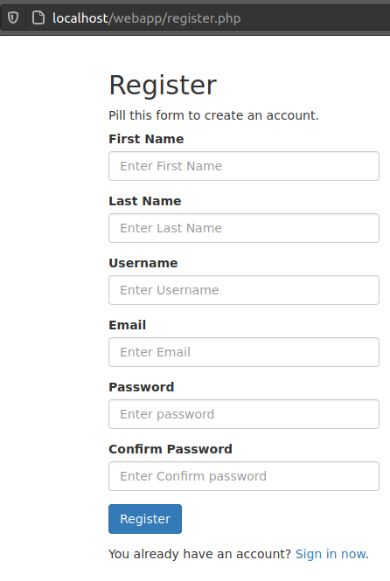
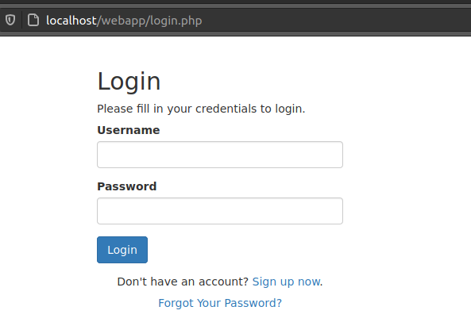
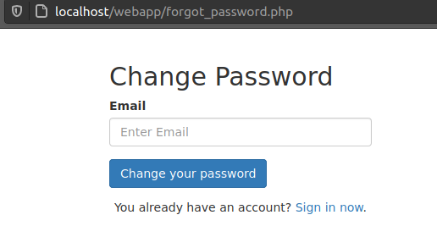

Slide 53
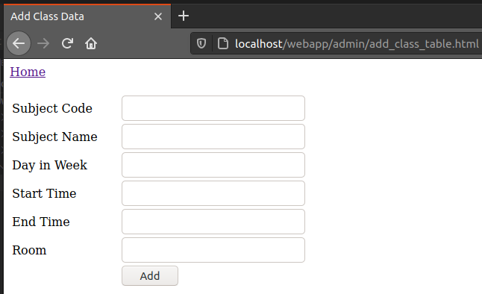
Admin

Slide 54
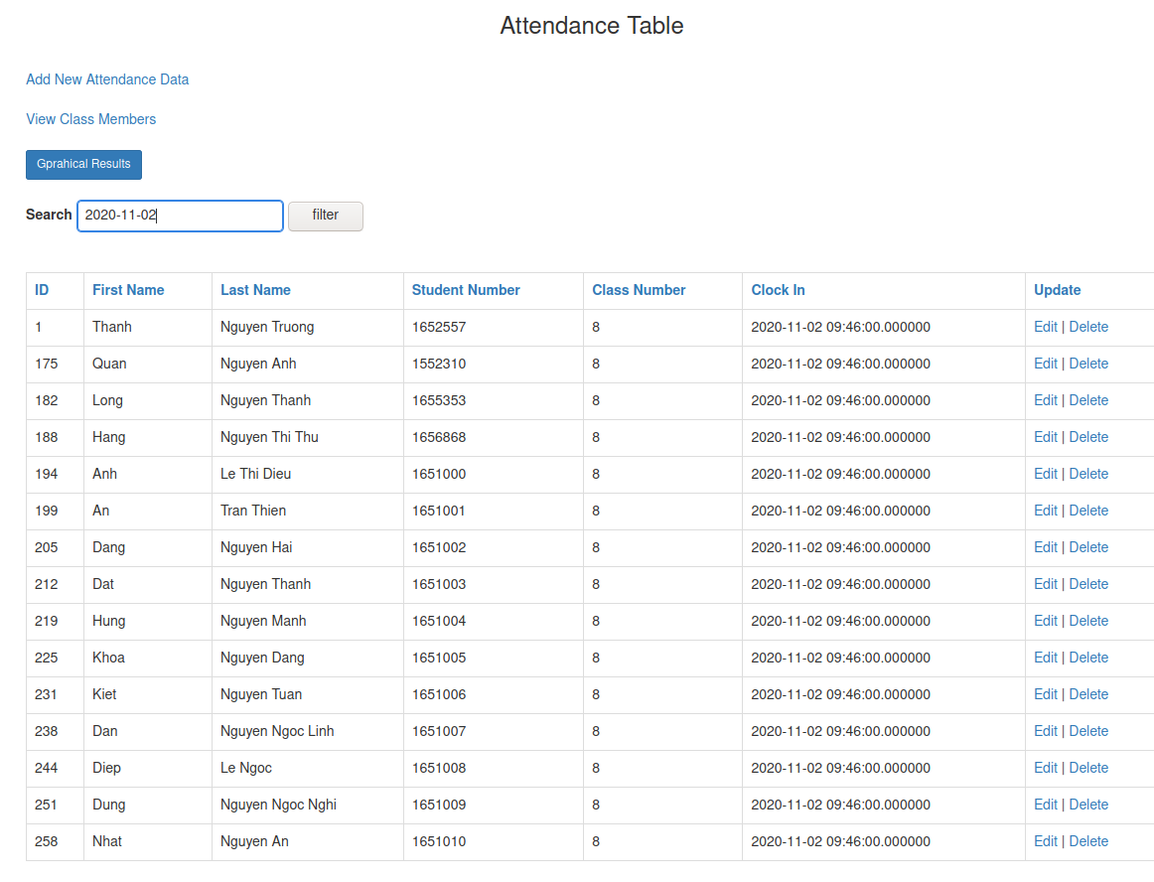
teacher

Slide 55
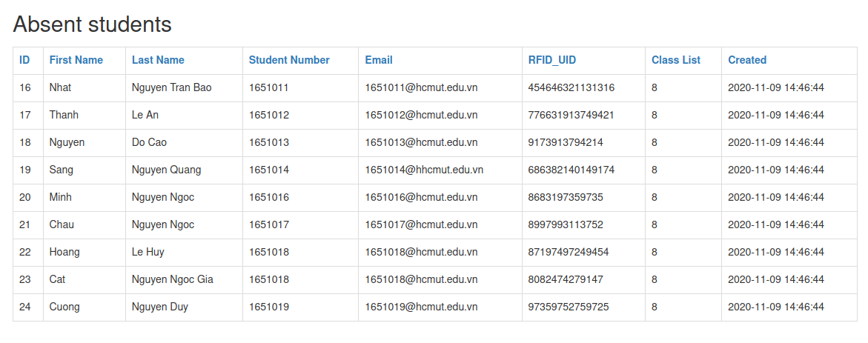
teacher

Slide 56
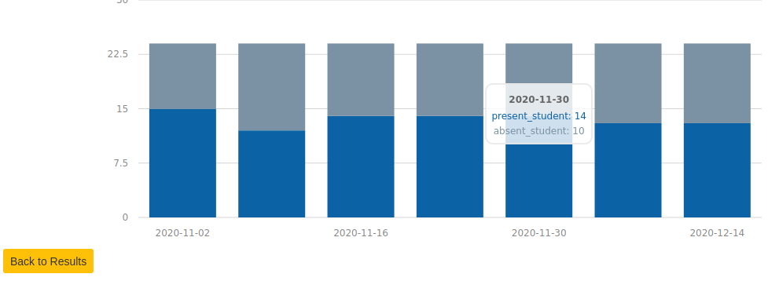
Attendance chart

Slide 57
Evaluation and testing
Testing
Evaluation

Slide 58

testing

Slide 59
testing
Time (s) | 1 | 2 | 3 | 4 | 5 | 6 | 7 | 8 | 9 | 10 | Average | Accuracy
Register | 87 | 93 | 86 | 72 | 100 | 69 | 91 | 110 | 98 | 105 | 91.1 | \
Correct all | 56 | 58 | 43 | 61 | 63 | 54 | 59 | 60 | 64 | 62 | 58 | 47/50 = 94 %
Wrong timetable | 50 | 41 | 48 | 42 | 39 | 46 | 43 | 39 | 49 | 34 | 43.2 | 49/50 = 98 %
Other face in db | 32 | 30 | 34 | 42 | 37 | 43 | 34 | 30 | 41 | 29 | 35.2 | 46/50 = 92 %
Unknown face | 30 | 32 | 37 | 40 | 33 | 44 | 45 | 51 | 38 | 33 | 38.3 | 49/50 = 98 %
Unregistered card | 26 | 25 | 31 | 28 | 27 | 29 | 31 | 28 | 25 | 29 | 27.9 | 50/50 = 100 %
Fake image | 75 | 78 | 80 | 77 | 81 | 79 | 86 | 76 | 84 | 87 | 80.3 | 50/50 = 100 %

Slide 60

Evaluation

Slide 61
Evaluation
Advantages
The system is easy to setup
Have all a checking attendance system need
Have data chart
Low cost
Disadvantages
Timing constraint
Low capacity of RAM
User interface is not good
Localhost

Slide 62
conclusion
Contributions
Result
Future Works

Slide 63

Contributions
Give a solution to check student attendance using IoT devices.
Combine RFID and Facial recognition
Detect fake image of faces

Slide 64

result

Slide 65

Future work
Setup web server and database server to another hosting
Move the project to the stronger system
Use other methods to improve the efficiency of anti-spoofing to replace eye blink detection
Create a better user interface
Improved code logic of the system

Slide 66

Thank you any question?

